Slide 1
CUSTOMER RETENTION
Telecom Customer
Churn Analysis
7,043
customers analysed
Identifying the customers most at risk and the actions that can improve retention
26.54% churn rate
Prepared from the completed Excel analysis workbook
Notes:
[Sources]
- telecom_customer_churn (1) COMPLET Eskill PROJECT 5.xlsx
[/Sources]

Slide 2
TELECOM CUSTOMER CHURN ANALYSIS
The analysis focuses on the customer groups most likely to leave
Project purpose
Measure customer churn and identify the service, contract, tenure, pricing and demographic factors associated with customer loss.
Analysis objectives
• Measure the overall churn rate and customer status.
• Compare churn across internet type, contract, tenure, charges, age and data usage.
• Identify the largest churn reasons and revenue at risk.
• Translate the findings into practical retention actions.
Notes:
[Sources]
- telecom_customer_churn (1) COMPLET Eskill PROJECT 5.xlsx
[/Sources]

Slide 3
DATA CLEANING AND PREPARATION
The data was checked, classified and validated before analysis
01
Customer records checked
Validated 7,043 unique customer IDs and confirmed that no duplicated customer rows remained.
02
N/A values reviewed
Interpreted N/A by context: no service, no offer or no churn reason—not automatically missing information.
03
Analysis bands created
Grouped age, tenure, monthly charge, data usage and population into consistent analytical categories.
04
Churn measures calculated
Created a churn indicator and calculated 1,869 churned customers from the full customer base.
05
Results validated
Reconciled the totals and confirmed the churn rate: 1,869 ÷ 7,043 = 26.54%. Churn reasons excluded non-churners.
Notes:
[Sources]
- telecom_customer_churn (1) COMPLET Eskill PROJECT 5.xlsx
[/Sources]

Slide 4
TELECOM CUSTOMER CHURN ANALYSIS
The company retained most customers, but more than one quarter had churned
7,043
₦21.37m
₦63.60
1,869
26.54%
Customers
Total revenue
Average charge
Churned
Churn rate
Overall interpretation
Of the 7,043 customers, 4,720 stayed, 1,869 churned and 454 recently joined. Retention should focus on identifiable high-risk groups rather than treating every customer equally.
Notes:
[Sources]
- telecom_customer_churn (1) COMPLET Eskill PROJECT 5.xlsx
[/Sources]

Slide 5
TELECOM CUSTOMER CHURN ANALYSIS
Customer status shows a stable base alongside a material churn problem
Insight
Recommended action
Customers who stayed had the longest average tenure, while churned customers had the shortest. This suggests that customers are most likely to leave early in their relationship with the company..
Introduce onboarding support, service check-ins and targeted retention offers during customers’ first few months.
Notes:
[Sources]
- telecom_customer_churn (1) COMPLET Eskill PROJECT 5.xlsx
[/Sources]

Slide 6
TELECOM CUSTOMER CHURN ANALYSIS
Fibre-optic customers recorded the highest churn rate among internet users
Insight
Recommended action
Fibre churn reached 40.72%, over twice the DSL rate. ‘No internet service’ replaces the N/A label.
Review fibre price, reliability and support, then contact dissatisfied users first.
Notes:
[Sources]
- telecom_customer_churn (1) COMPLET Eskill PROJECT 5.xlsx
[/Sources]

Slide 7
TELECOM CUSTOMER CHURN ANALYSIS
Month-to-month contracts created the clearest concentration of churn
Insight
Recommended action
Month-to-month churn was 45.84%, versus 10.71% for one-year and 2.55% for two-year contracts.
Give suitable month-to-month customers a simple incentive to choose a one-year plan.
Notes:
[Sources]
- telecom_customer_churn (1) COMPLET Eskill PROJECT 5.xlsx
[/Sources]

Slide 8
TELECOM CUSTOMER CHURN ANALYSIS
New customers were the most vulnerable, while long-tenure customers were resilient
Insight
Recommended action
New-customer churn reached 47.44%. Churned customers averaged 18 months; stayed customers averaged 41 months.
Use first-year onboarding, service checks and early-risk outreach.
Notes:
[Sources]
- telecom_customer_churn (1) COMPLET Eskill PROJECT 5.xlsx
[/Sources]

Slide 9
TELECOM CUSTOMER CHURN ANALYSIS
Churn increased sharply as monthly charges moved above the low band
Insight
Recommended action
High-charge groups churned at about 33%, compared with only 10.72% in the low-charge group.
Offer high-charge customers value reviews and better-sized plans before cancellation.
Notes:
[Sources]
- telecom_customer_churn (1) COMPLET Eskill PROJECT 5.xlsx
[/Sources]

Slide 10
TELECOM CUSTOMER CHURN ANALYSIS
Older customers experienced a higher churn rate than younger groups
Insight
Recommended action
Elderly customers churned at 32.55%, around eight to ten points above the other age groups.
Test clearer communication and assisted support for older customers.
Notes:
[Sources]
- telecom_customer_churn (1) COMPLET Eskill PROJECT 5.xlsx
[/Sources]

Slide 11
TELECOM CUSTOMER CHURN ANALYSIS
Competitor-related churn accounted for the largest amount of lost customer revenue
Insight
Recommended action
Competitor-related churn represented ₦1.69m. N/A reasons relate mainly to customers who did not churn and were excluded.
Benchmark rival devices, data and offers, then build targeted win-back plans.
Notes:
[Sources]
- telecom_customer_churn (1) COMPLET Eskill PROJECT 5.xlsx
[/Sources]

Slide 12
TELECOM CUSTOMER CHURN ANALYSIS
High-data users churned more often than low-data users
Insight
Recommended action
High-data users churned at 34.04%, versus 22.02% among low-data users.
Monitor heavy users and proactively offer suitable data plans or technical support.
Notes:
[Sources]
- telecom_customer_churn (1) COMPLET Eskill PROJECT 5.xlsx
[/Sources]

Slide 13
TELECOM CUSTOMER CHURN ANALYSIS
In cities churn rate is higher in tank bus stop
Insight
Recommended action
Tank Bus Stop recorded the highest churn rate at 34.55%, while Isiokpo had the lowest at 19.64%. This is a difference of approximately 14.91 percentage points, showing that customer retention varied considerably across the selected location
Investigate service quality, network coverage, pricing complaints and competitor activity around Tank Bus Stop and Abuloma. Retention campaigns should be prioritised in these higher-churn locations.
Notes:
[Sources]
- telecom_customer_churn (1) COMPLET Eskill PROJECT 5.xlsx
[/Sources]

Slide 14
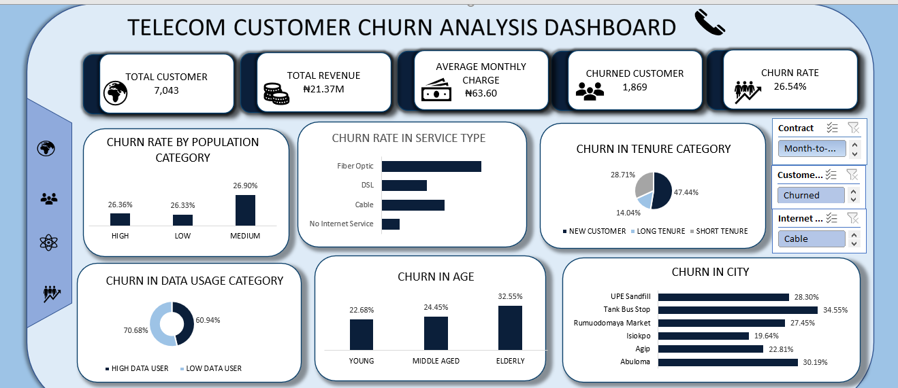
DASHBOARD

Slide 15
OVERALL INSIGHTS
Churn is concentrated in customers facing weak commitment, early-tenure risk and service pressure
01
The churn problem is material
1,869 customers churned, producing an overall churn rate of 26.54%.
02
Commitment strongly matters
Month-to-month churn was 45.84%, while two-year churn was only 2.55%.
03
Early tenure is critical
New customers churned at 47.44%; stayed customers averaged 41 months of tenure.
04
Fibre requires attention
Fibre-optic churn reached 40.72%, the highest among active internet types.
05
Value and competition drive risk
High charges, heavy data use and competitor-related losses point to a value-experience gap.
Notes:
[Sources]
- telecom_customer_churn (1) COMPLET Eskill PROJECT 5.xlsx
[/Sources]

Slide 16
RECOMMENDATIONS
Six actions should form the core of the retention programme
01
Strengthen onboarding
Contact new customers early and resolve setup or service difficulties quickly.
02
Convert suitable contracts
Give month-to-month customers a clear reason to choose a one-year plan.
03
Fix fibre pain points
Investigate fibre reliability, support, speed and price perceptions.
04
Intervene before cancellation
Use tenure, charge and data-usage signals to prioritise proactive outreach.
05
Compete on customer value
Respond to rival offers with better-fit plans, devices and service—not blanket discounts.
Notes:
[Sources]
- telecom_customer_churn (1) COMPLET Eskill PROJECT 5.xlsx
[/Sources]

Slide 17
RECOMMENDATIONS
Six actions should form the core of the retention programme
06
Strengthen onboarding
Introduce location-based retention strategies by prioritising areas with the highest churn rates, particularly Tank Bus Stop and Abuloma. Customer complaints, network performance, pricing and competitor activity should be reviewed in these locations, while successful practices from lower-churn locations such as Isiokpo should be identified and applied where appropriate
Notes:
[Sources]
- telecom_customer_churn (1) COMPLET Eskill PROJECT 5.xlsx
[/Sources]

Slide 18
RECOMMENDATIONS
six actions should form the core of the retention programme
Introduce location-based retention strategies by prioritising areas with the highest churn rates, particularly Tank Bus Stop and Abuloma. Customer complaints, network performance, pricing and competitor activity should be reviewed in these locations, while successful practices from lower-churn locations such as Isiokpo should be identified and applied where appropriate.
06
Target high churn location
Notes:
[Sources]
- telecom_customer_churn (1) COMPLET Eskill PROJECT 5.xlsx
[/Sources]

Slide 19
CONCLUSION
Retention growth depends on improving the early customer experience
The customer base is mostly stable, but churn is concentrated among new customers, month-to-month subscribers, fibre users, high-charge customers and heavy data users.
The company should combine targeted outreach with service improvements and longer term value offers, using segment level churn as the measure of success
Notes:
[Sources]
- telecom_customer_churn (1) COMPLET Eskill PROJECT 5.xlsx
[/Sources]

